Slide 1
Renewable Energy and Economic Redevelopment
at the former Brunswick Naval Air Station
Notes:
Introduction
Today I’ll be talking about Renewable Integrated Microgrids, which is NREL’s approach to microgrid design.

Slide 2
Renewable Energy and Economic
Redevelopment at Brunswick Landing
Presentation for E2Tech
Midcoast Regional Redevelopment Authority
Community Forum
Nov. 3 2011
Scott Huffman
Senior Engineer
Integrated Applications Office
National Renewable Energy Laboratory

Slide 3
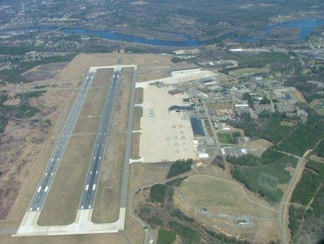
Overview
Who is NREL?
Describe the Brunswick Study
Present the results of the Brunswick Study
Present some potential options for Brunswick
Questions

Slide 4
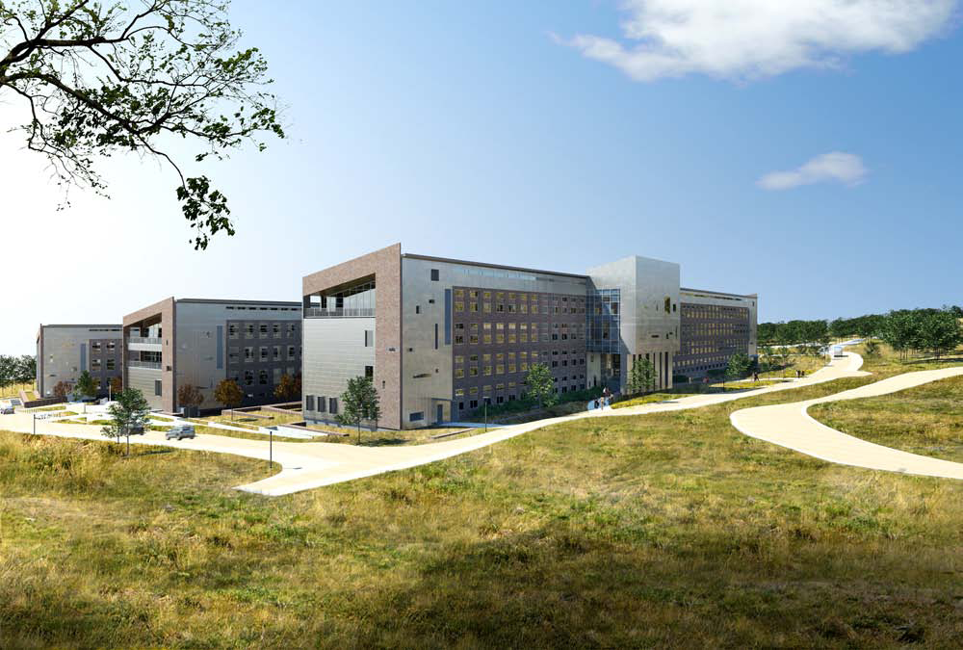


Slide 5

Major DOE National Laboratories
NREL is Operated for the U.S. Department of Energy by the Alliance for Sustainable Energy
Pacific Northwest
INL
Brookhaven
Lawrence Berkeley
Argonne
NETL
NREL
Lawrence Livermore
Oak Ridge
Sandia
Los Alamos
Nuclear Security
Science
Energy Efficiency and Renewable Energy
Nuclear Energy
Fossil Energy
Environmental Management
Savannah River

Slide 6
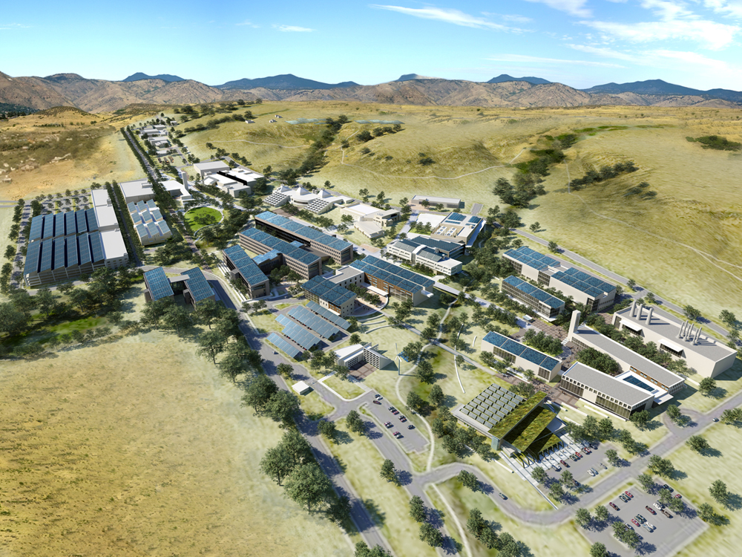
What Makes NREL Unique?
Only national laboratory dedicated to renewable energy and energy efficiency R&D
Collaboration with industry and university partners is a hallmark
Ability to link scientific discovery and product development to accelerate commercialization
Focus on serving Federal agencies

Slide 7
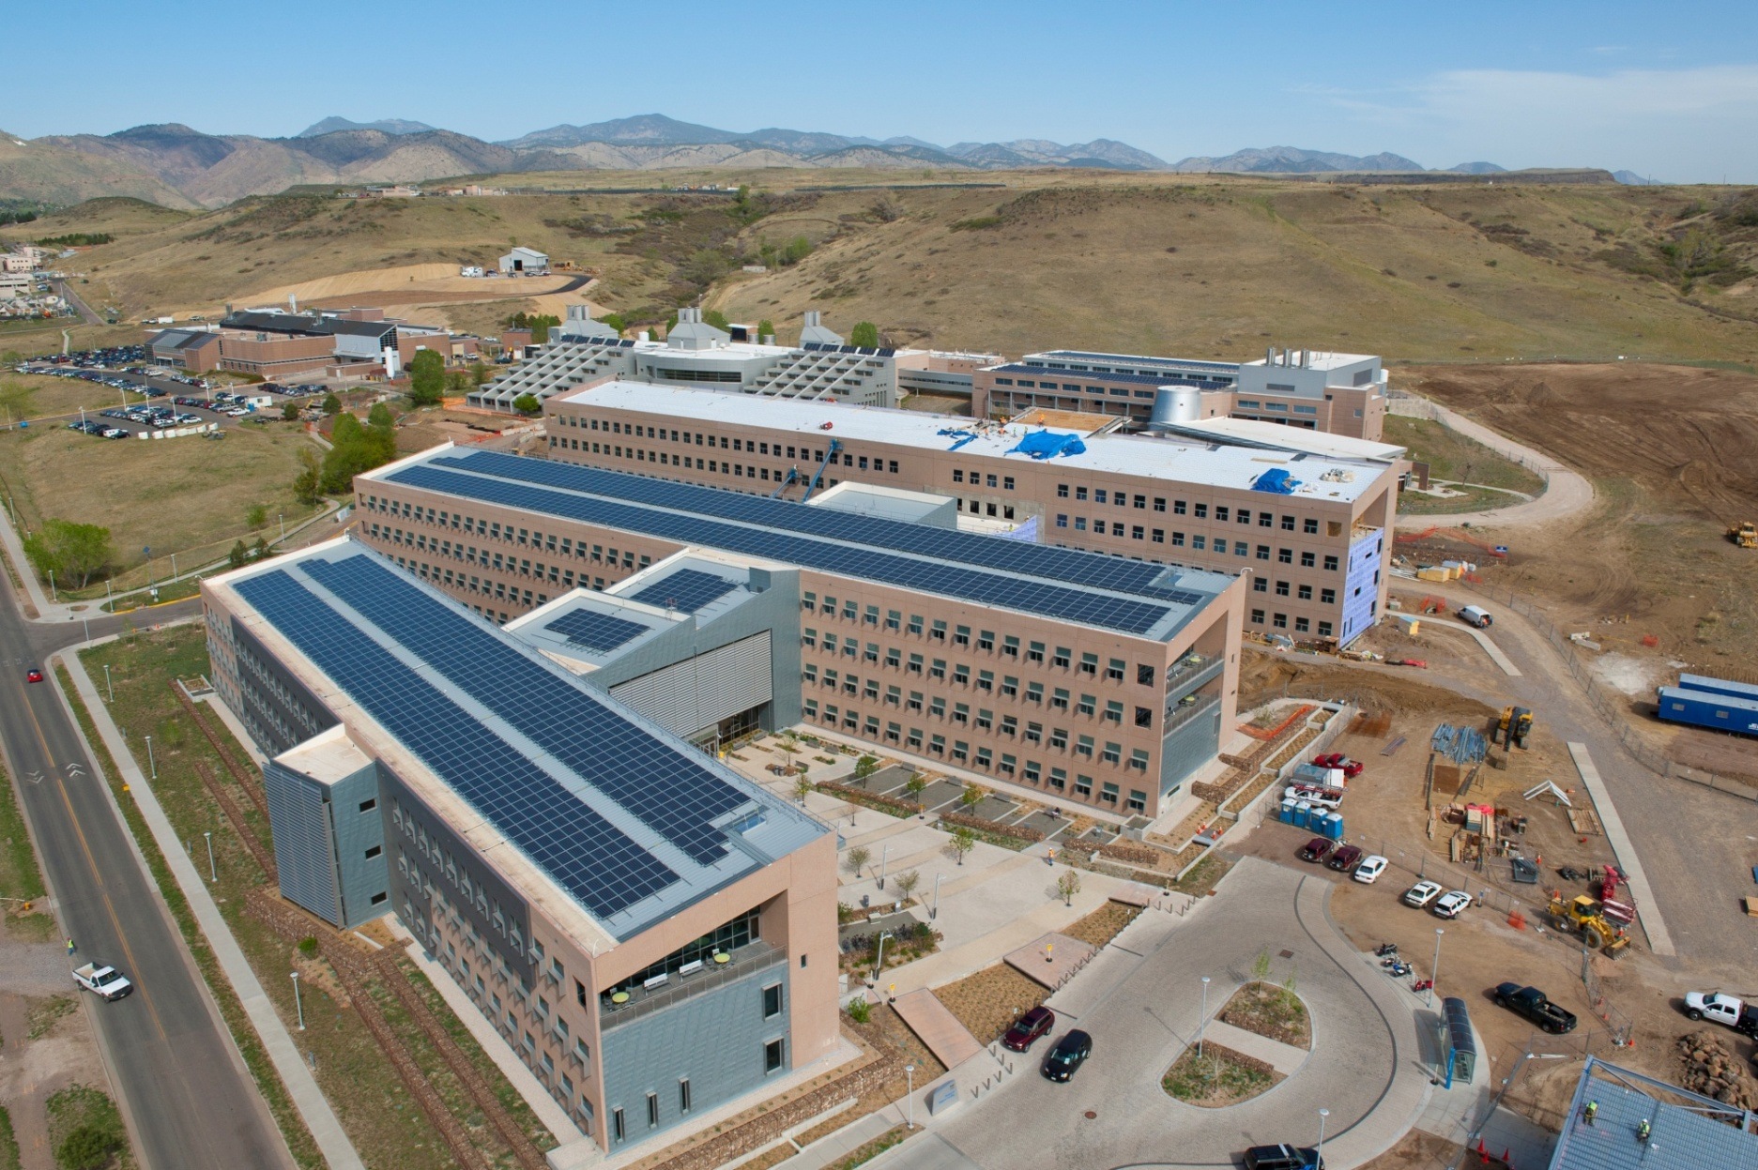
The Most Energy Efficient
Commercial Scale Building in the World

Slide 8
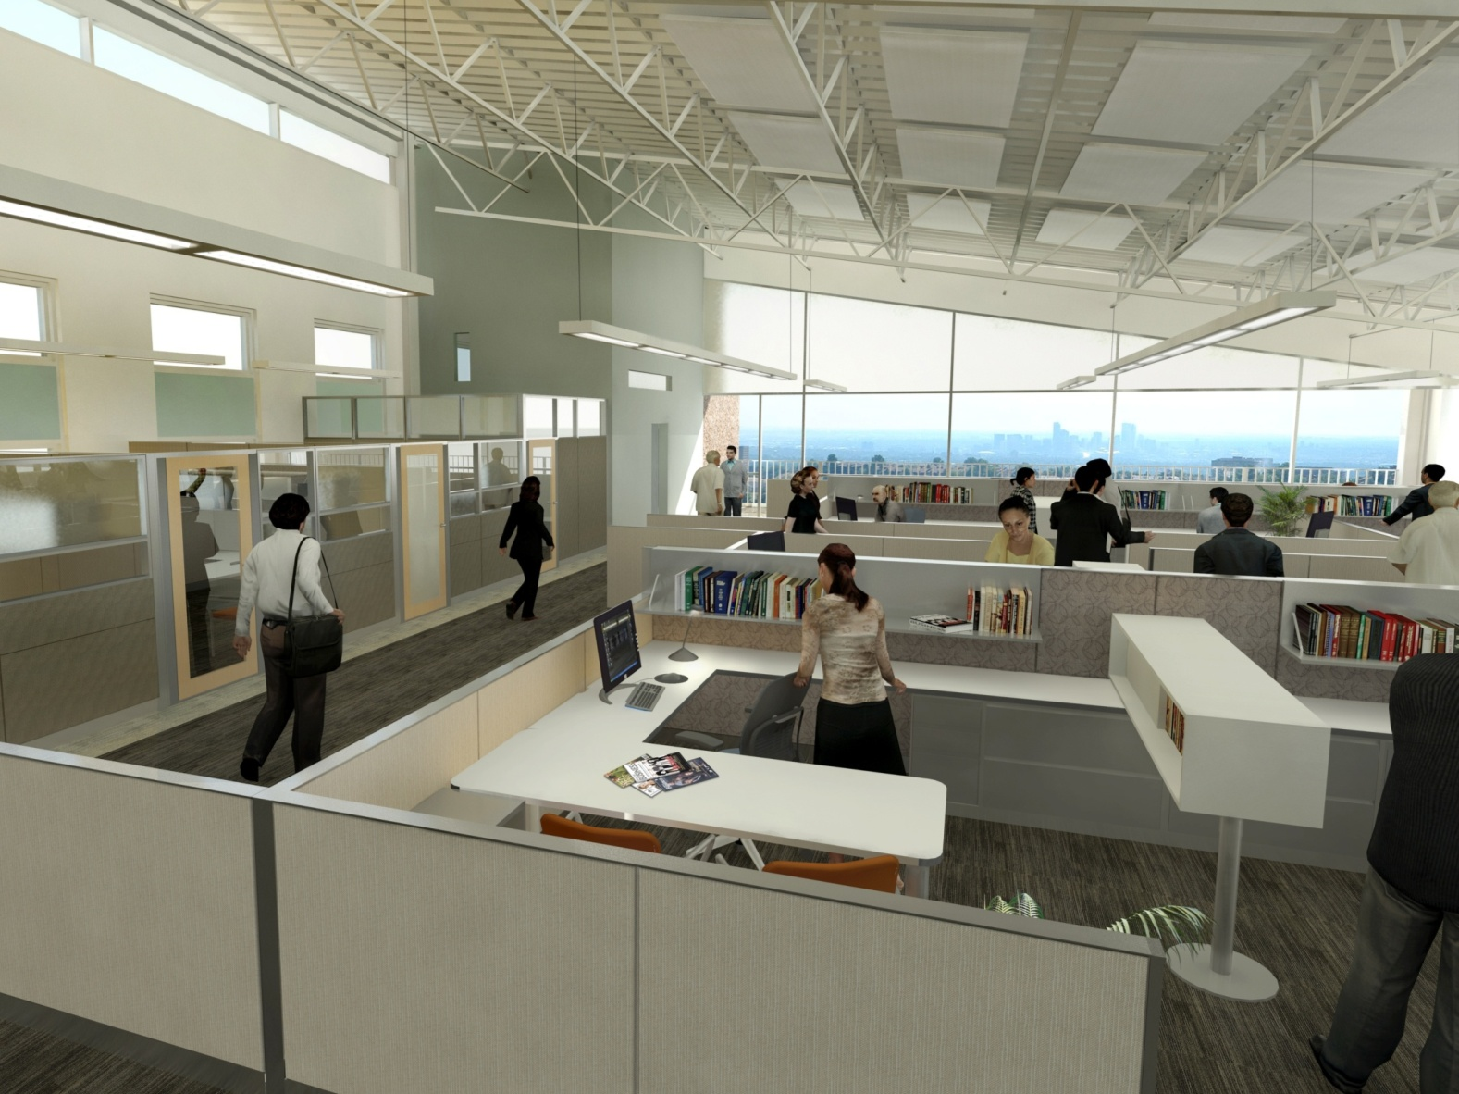
Working in a Net-Zero Energy Building

Slide 9
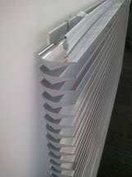
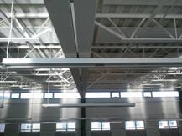

Seeing is believing…….

Slide 10
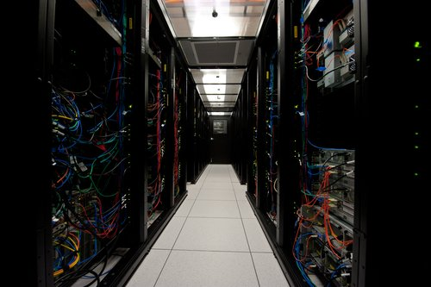
The Most Energy Efficient Data Center in the World

Slide 11
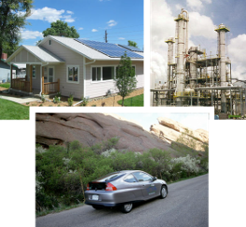
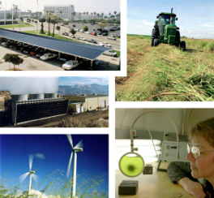
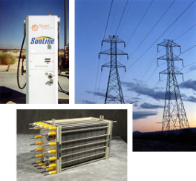
Scope of NREL’s R&D Programs
FOUNDATIONAL SCIENCE AND ADVANCED ANALYTICS
Efficient Energy Use
Renewable Resources
Energy Delivery & Storage
Vehicle Technologies
Building Technologies
Industrial Technologies
Wind
Water
Solar
Biomass
Geothermal
Electricity Transmission
and Distribution
Alternative Fuels
Hydrogen Delivery and
Storage

Slide 12
From Research to Deployment
Technology-Specific Deployment
Technology-Neutral
Deployment
Buildings & Electricity
Solar
Weatherization
Wind & Hydro
Solar Decathlon
Solar America Cities
Geothermal
Strategic Energy Analysis
Wind Powering America
Project
Development
& Finance
Biomass & Biofuels
State, Local, & Tribal
Integrated Deployment (ID)
Vehicles
FEMP - Federal Facilities
Clean Cities
and Alternative Fuels
Data Center
Technology Assessment
& Screening
Hydrogen & Fuel Cells
Project Execution
Support
Industrial Technologies
TECHNOLOGY DEPLOYMENT PROGRAMS
DEPLOYMENT
SUPPORT FUNCTIONS
R&D AND ANALYSIS PROGRAMS

Slide 13
NREL offers energy efficiency, renewable energy, new construction and net zero assessment, optimization and audit tools and capabilities
Broad Screening, Inventory and Optimization
Climate leaders Greenhouse Gas Inventory
Renewable Energy Optimization (REO)
Renewable Screening Spreadsheets (for Navy)
Net-zero Assessments for Bases, Campuses and Islands
Buildings Assessments
Energy Efficiency and Renewable Energy Assessment
Tool and Training
Equest\DOE-2
Building Energy Optimization (BEopt)
LEED\Design Charrettes
Alternative Finance Capability (ESPC, UESC, PPAs)
Vehicles
Petroleum Reduction Planning Tool (PREP)
Alternative Fueling Station Locator
Infrastructure
Distributed Engineering Workstation (DEW)
Supply Side Options
Hybrid Optimization Model (HOMER)
In My Back Yard (IMBY)
Solar Advisor Model
Ocean Energy Assessments
TEAM Solar\Wind\Biomass
Notes:
Integrated approach, systemic design solutions

Slide 14
Brunswick Renewable Energy Study
EPA Funded the Study to Determine Renewable Energy Options for Economic Redevelopment of BNAS
Open to all options – Blank Sheet
Balance the Limited Budget with the Level of Detail
First: Estimate the energy consumption of the future development. (no one knows the future)
Next: NREL Looked at 9 different Renewable Energy Technologies
NREL Looked at other potential “Systemic” options

Slide 15
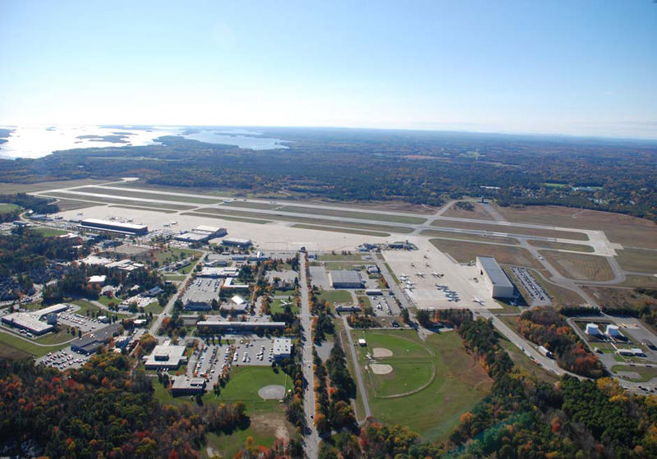
Estimating Energy Use and Savings
Estimated the Future Energy Use at BNAS
Electricity and Heat - Industrial Processes Unknown
Staged Approach - Adding Detail in Future
Estimated Size and Rough Cost of a New Underground Hot Water Distribution Heating Loop.
Assumed Worse Case: No Tenants to Purchase Heat
Estimated Federal and State Incentives.

Slide 16
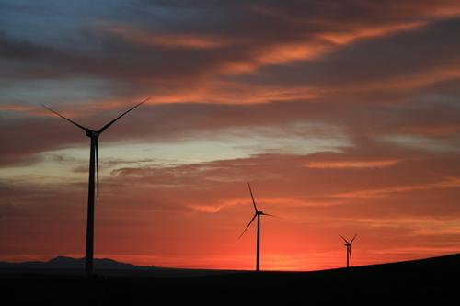
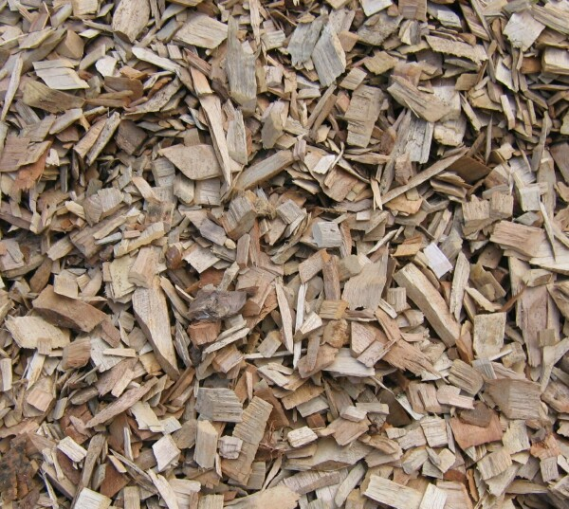
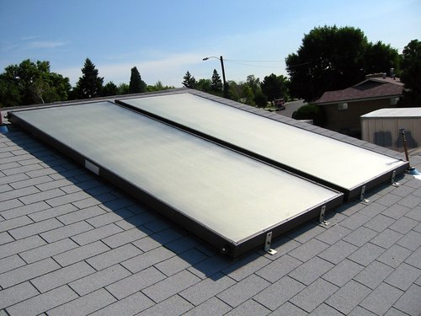
Renewable Energy Technologies Examined for this Study
Solar Electric Panels (PV) Photovoltaics
Solar Domestic Water Heating
Solar Ventilation Air Heating
Wind Turbines
Geothermal Heat Pumps
Biomass Combined Heat and Power Systems
Fuel Cells
Micro Gas Turbines
Smart Grid

Slide 17
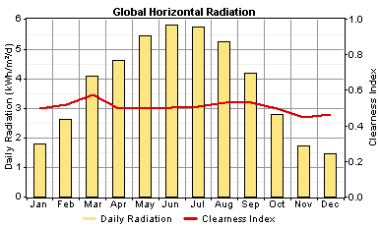
Brunswick Solar Radiation

Slide 18
Solar Electric Photovoltaic Results:
Calculations made using two different NREL Softwares: REO Software (Renewable Energy Optimization) and HOMER Software (Hybrid Optimization Model for Electric Renewables) using Solar Data specific to BNAS
Payback in 16 years @ installed cost of $4.50/Watt for a 100KW array size.

Slide 19
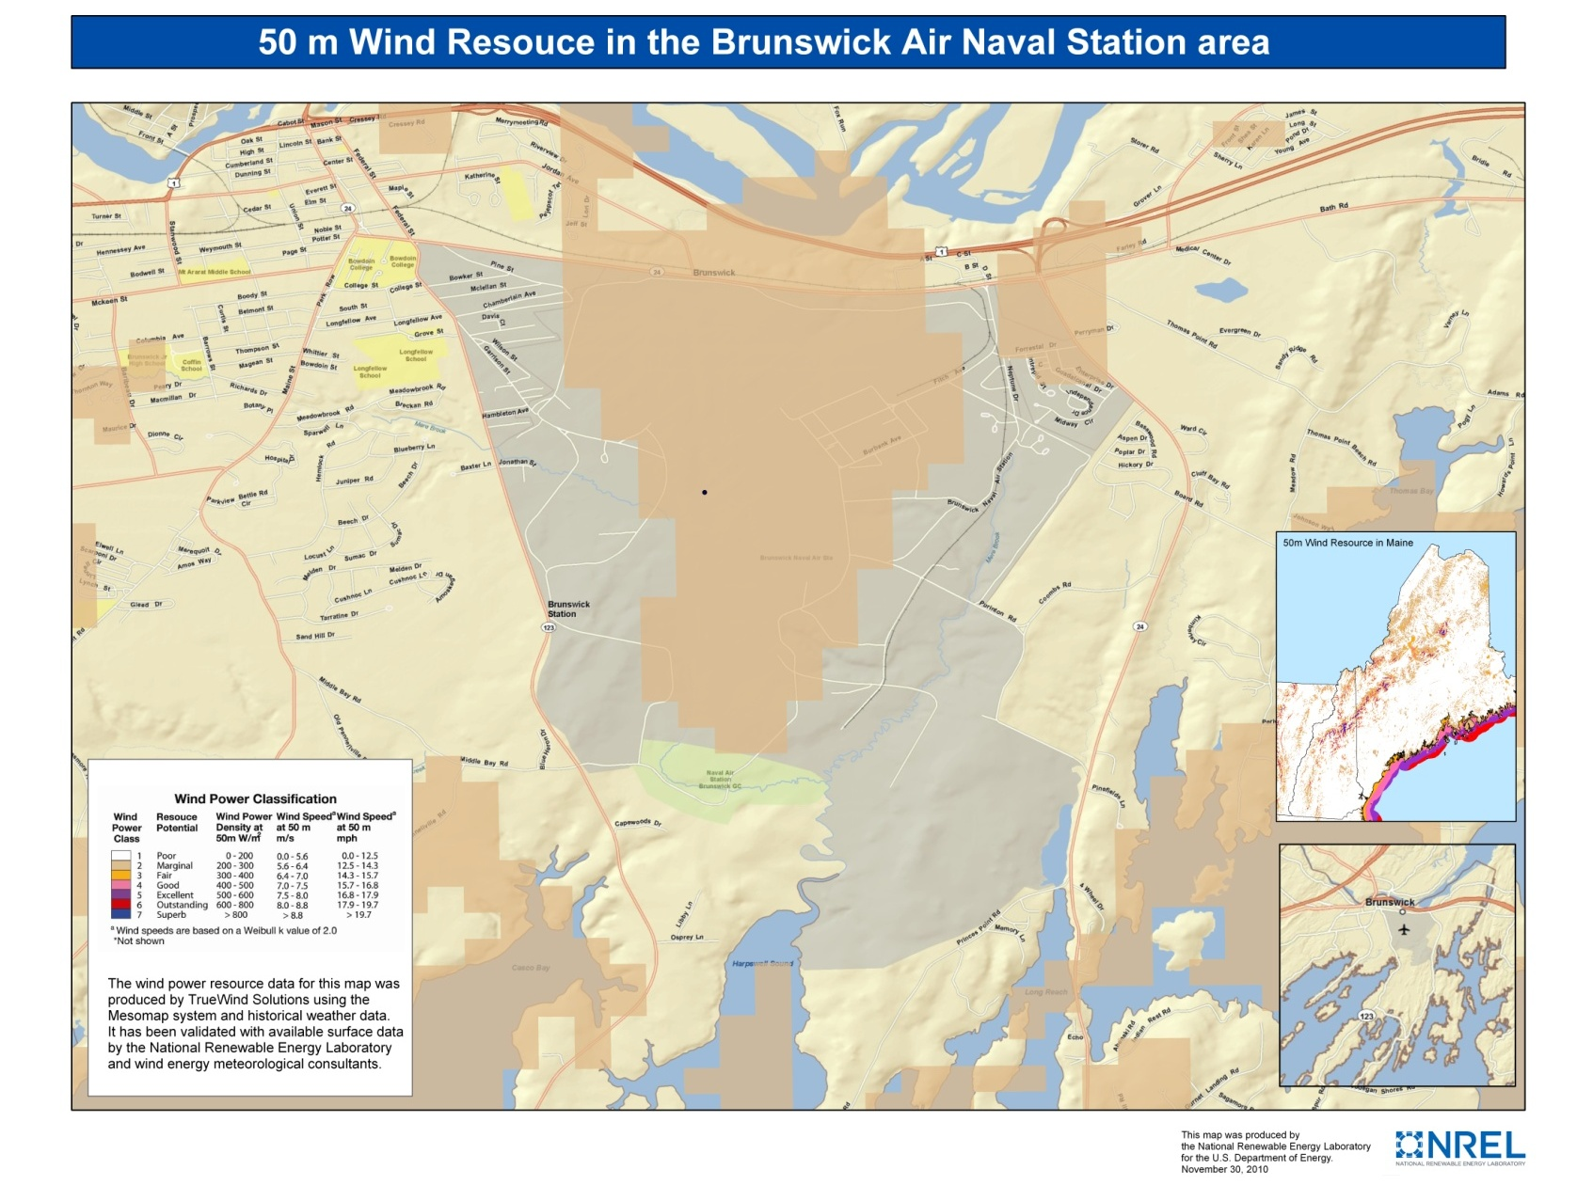
Wind

Slide 20
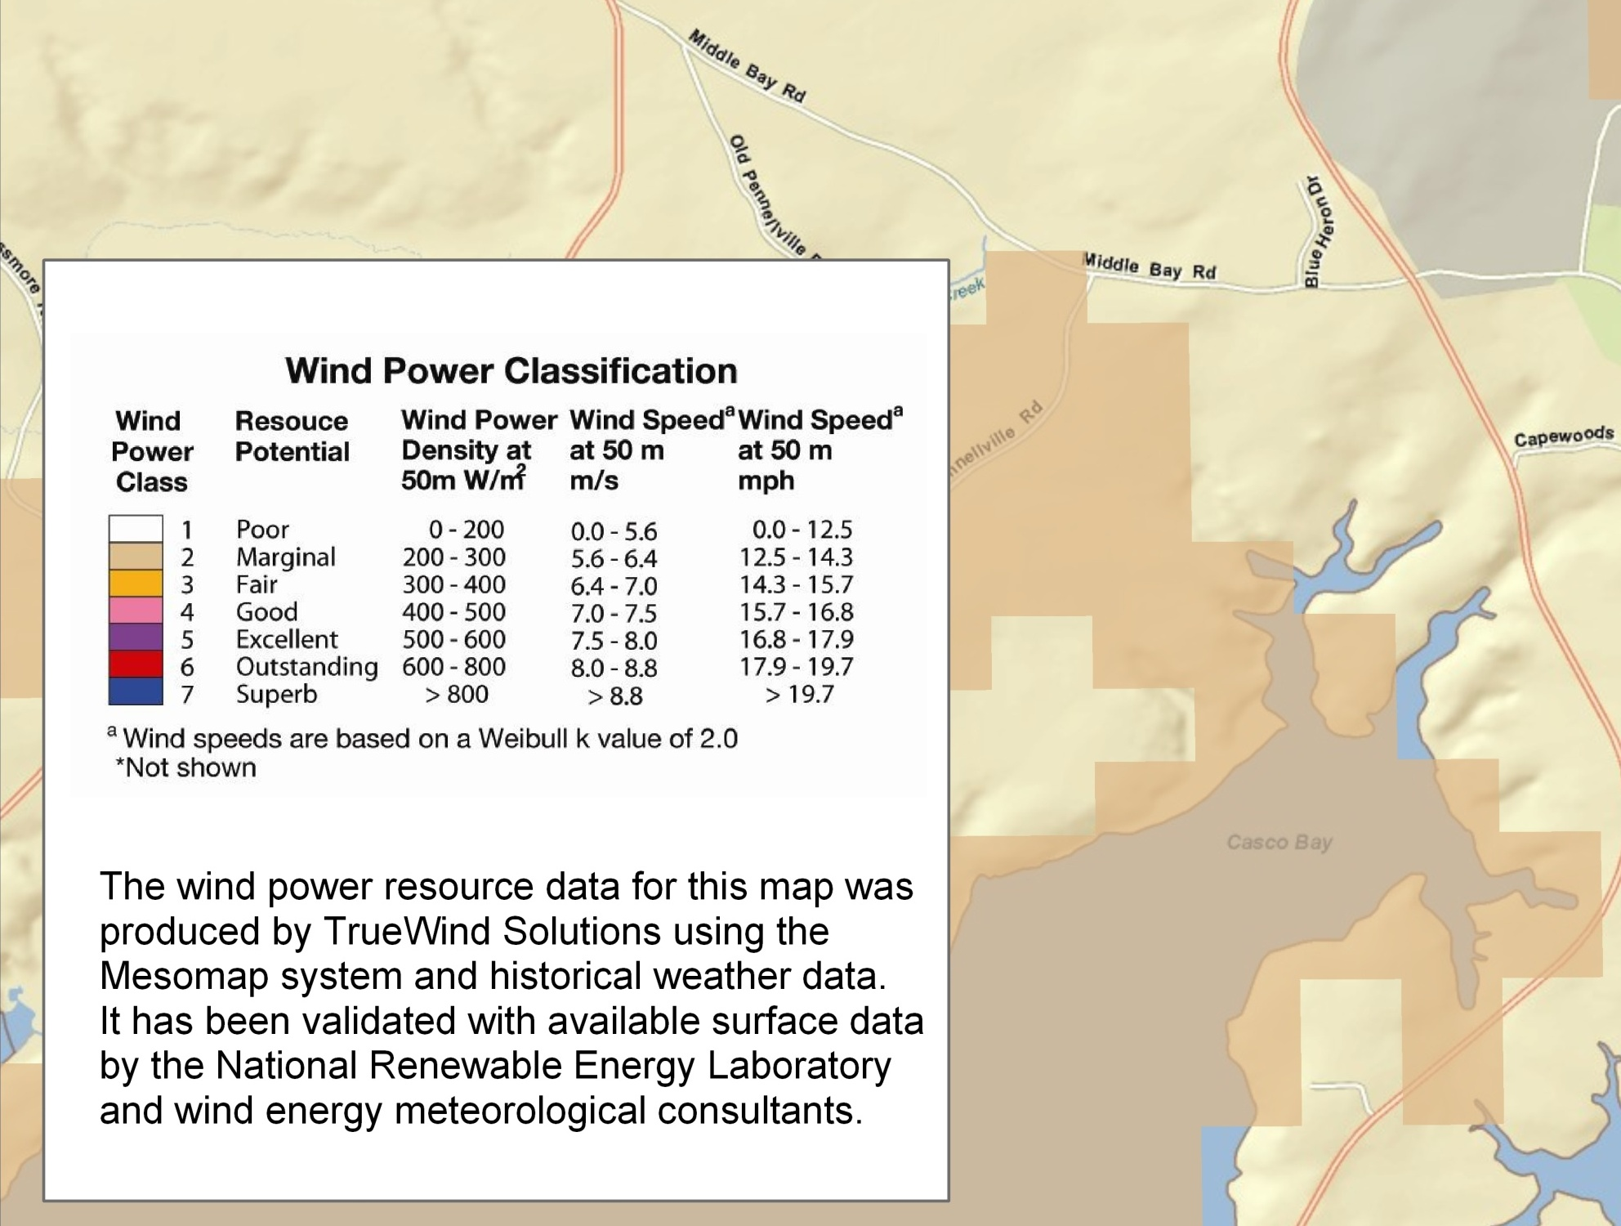
Wind

Slide 21
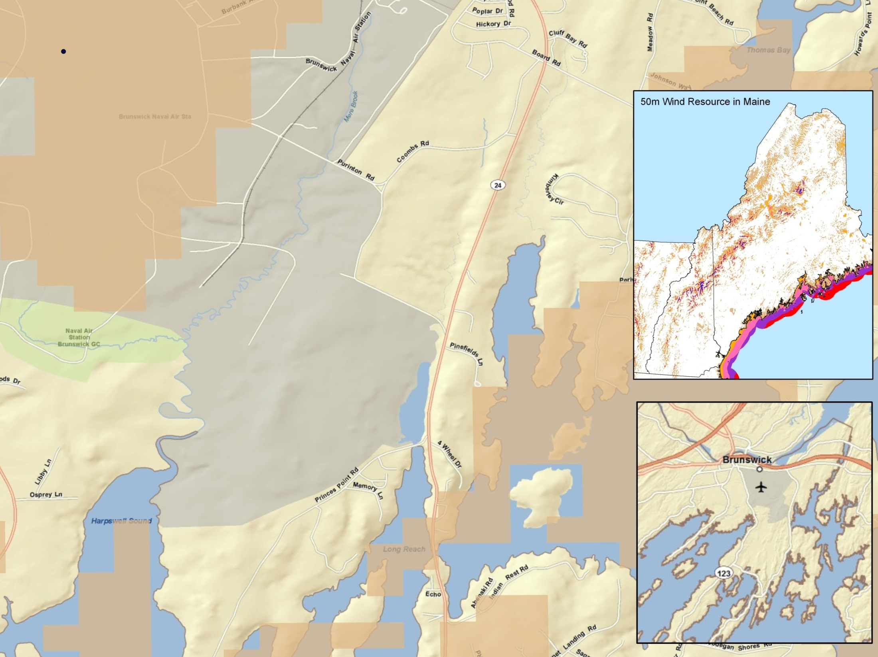

Slide 22

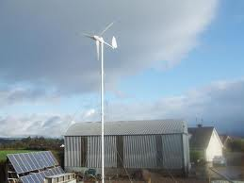
Wind Results
15 year Payback for 100 KW thru 10 KW Turbines
Local State Incentive brought payback down to 8.8 years for a 3kW Turbine.

Slide 23
Solar Domestic Hot Water Heating Results
8 Year Payback if Replacing Electric
37 Yr payback if replacing Natural Gas

Slide 24
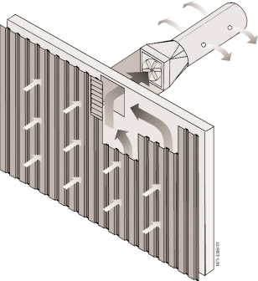
Transpired Solar Collectors

Slide 25
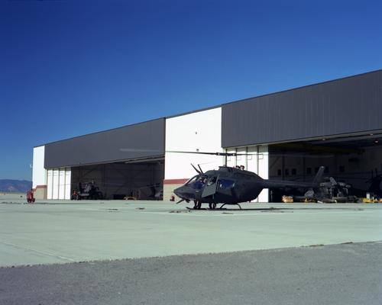
Solar Preheating of Ventilation Air
Retrofitting onto an Existing Building
Payback = 7.4 yrs
If Retrofitted as part of an Exterior Renovation
Payback = 2 years

Slide 26
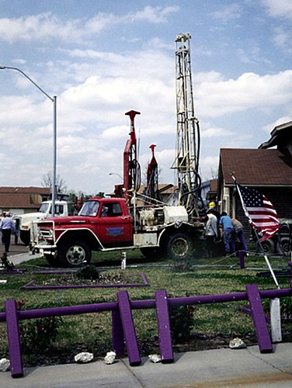
Geothermal (Ground Source) Heat Pump
Retrofit costs for 10,000 ft2 building $126,000 based on estimates from area GHP contractors.
Energy Model estimated a savings from GHP compared to existing Natural Gas system = $2,166/yr
Payback 37 years….BUT
Potential Avoided Cost of Replacing Existing Gas Furnace

Slide 27
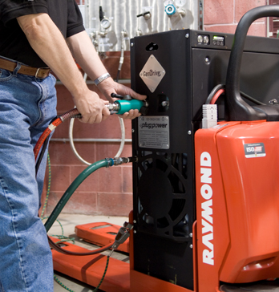
Fuel Cells
Utilize hydrogen to create electricity
At this point, fuel cells are only cost effective when providing additional money saving benefits such as saving recharging time and labor for fork lifts.

Slide 28
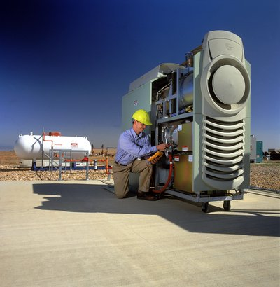
Micro Gas Turbines
Small versions of the Natural Gas Combustion Turbines used by utilities (Electricity and Heat)
Payback of 6.2 years if all electricity and heat are sold.
17 year payback if 50% of heat sold
25 year payback if zero heat is sold

Slide 29
Combined Heat and Power (CHP)
(Cogeneration)

Slide 30
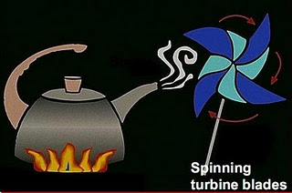
Electric Generation Simplified

Slide 31
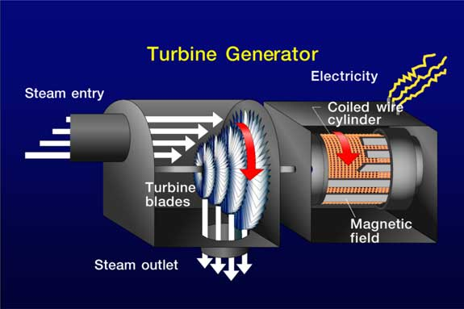
More Detailed

Slide 32
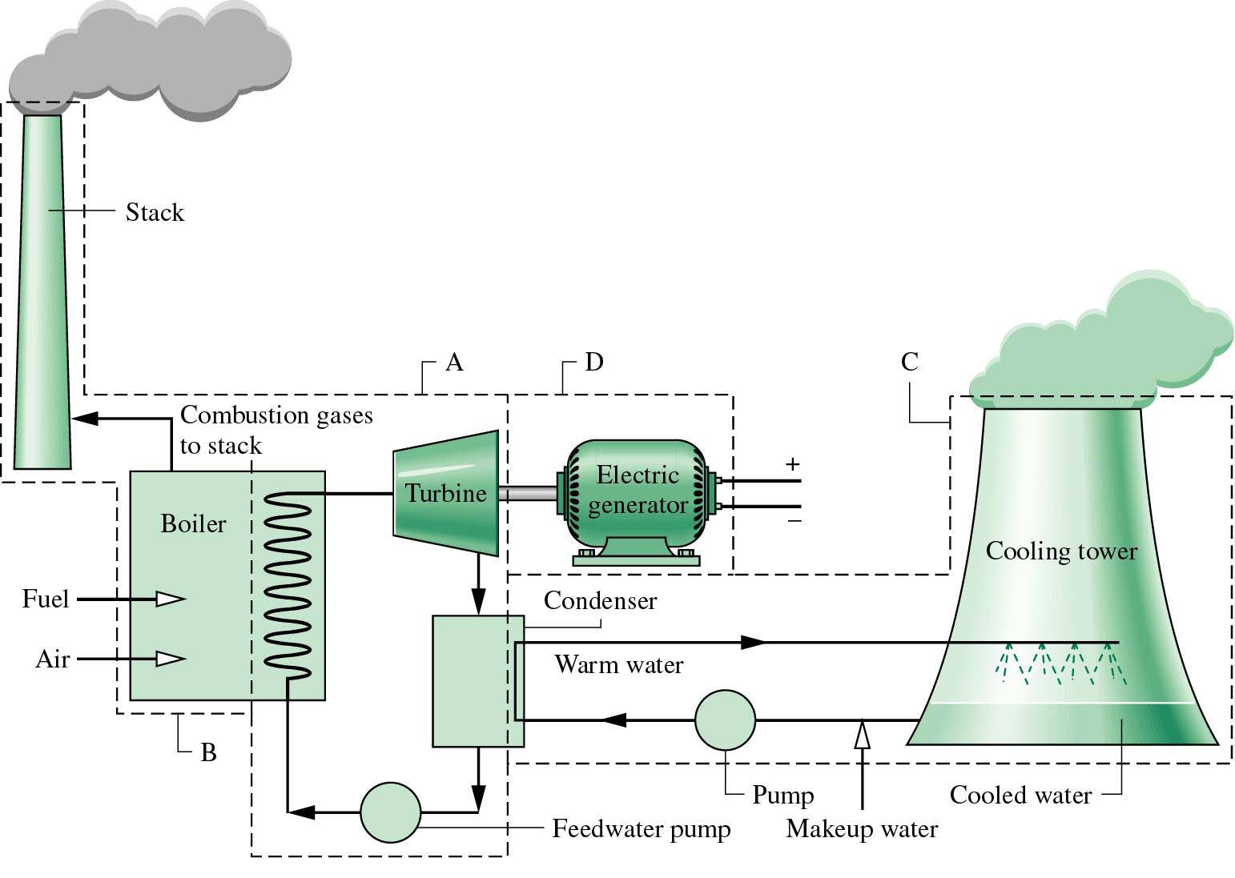
Whole System
~ 40% Efficient
60% Waste!

Slide 33
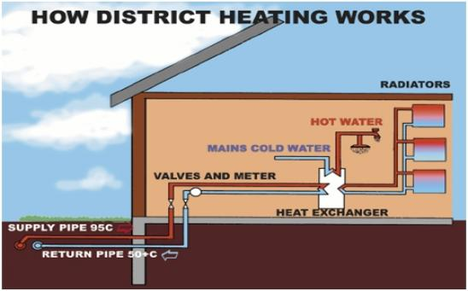

Slide 34
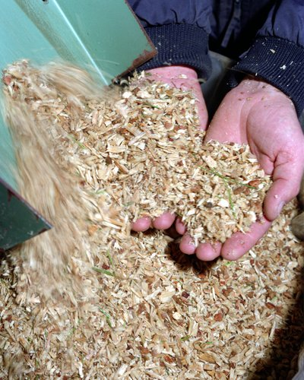
Biomass Combined Heat and Power (CHP)
Payback 10 years
Leasing gives Positive Cashflow of $133,000/Yr
Using Best Available Technology
Assumes Worst Case - Selling No Waste Heat
Includes the Cost of Installing a New Underground District Heating Loop
Not Counting Potential State of Maine, or USDA Grants
Not Counting Potential New Market Tax Credits (~25% reduction in cost)

Slide 35
Additional Benefits
Use “Free Heat” to Attract Tenants.
Trade “Free Heat” to Tenants in Exchange for Building Upgrades. (Cascading Local Effect)
Create New Industries in Brunswick.

Slide 36
“Systemic” Benefits
Getting 2 Bangs per Buck
Grandma: “It’s just common sense not to let things go to waste” (Depression Era Frugality)
Cradle to Cradle Design
The “Waste” from One Process or Company Becomes the “Food” for Another
Investing with an Eye to the Future

Slide 37
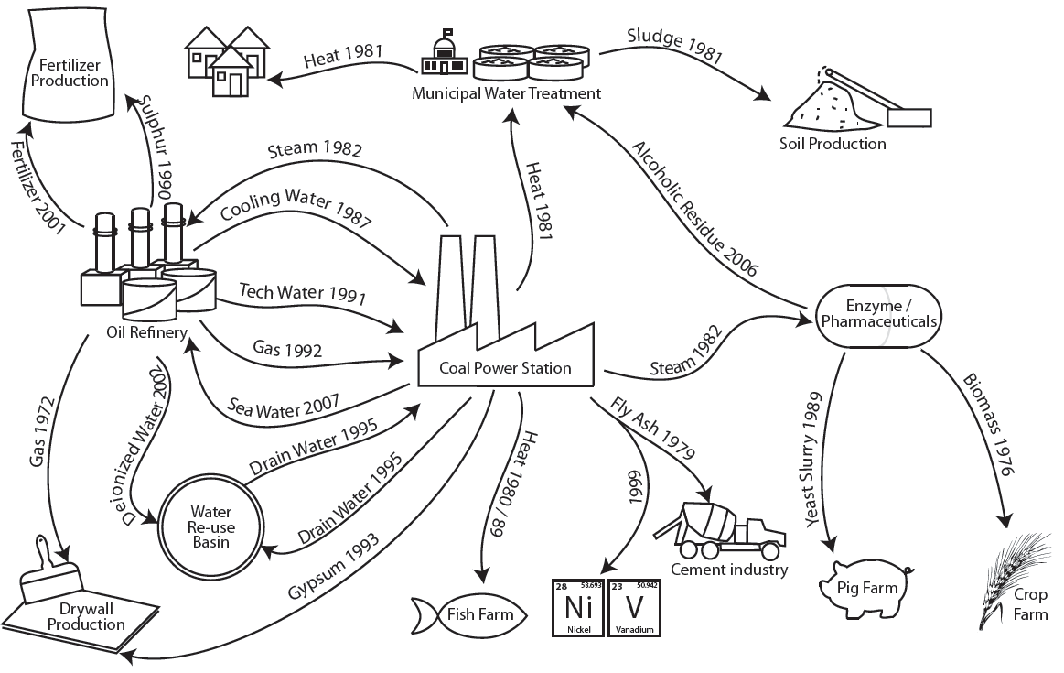
Kalundborg Denmark

Slide 38
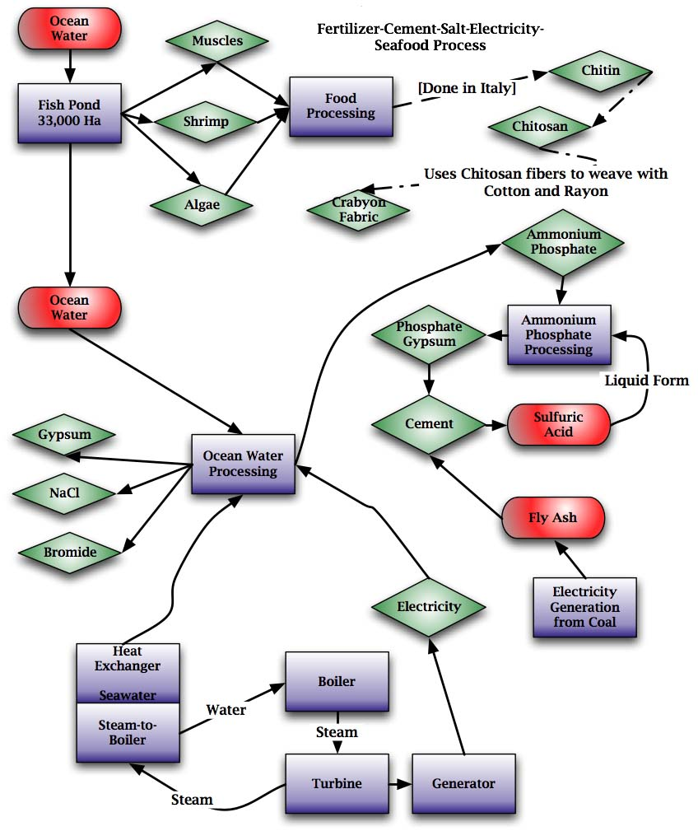
“Systemic” Economic Development

Slide 39
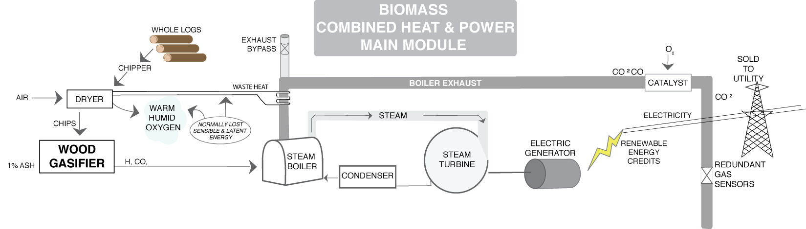
Basic Biomass

Slide 40
Basic Biomass

Slide 41
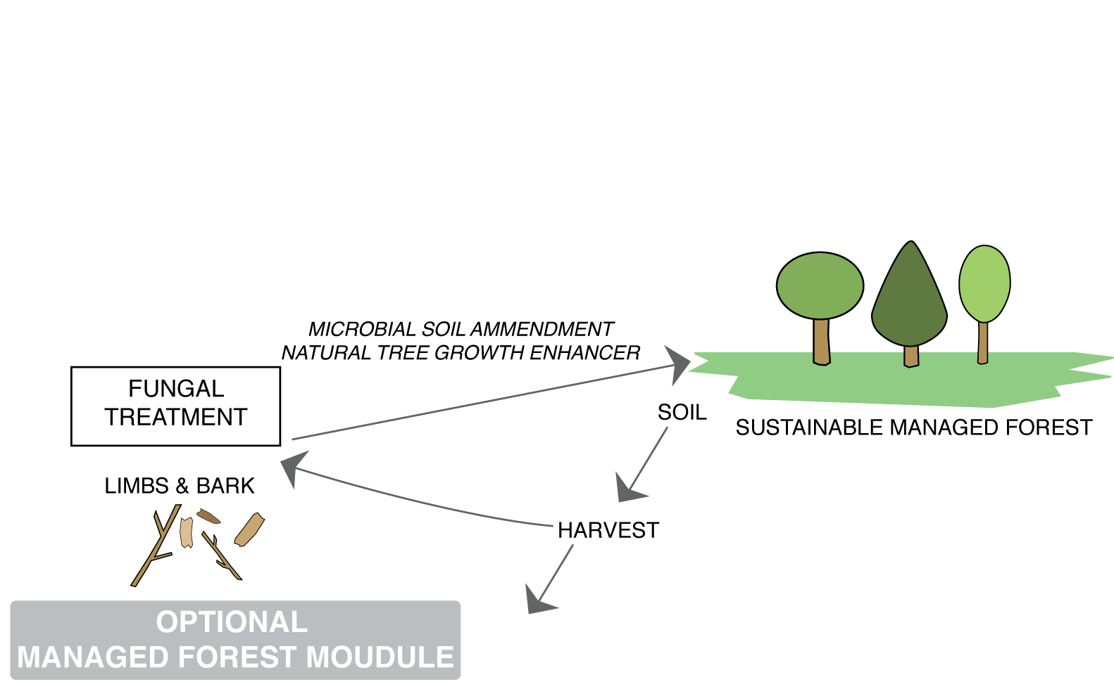
Sustainably Managed Forest

Slide 42
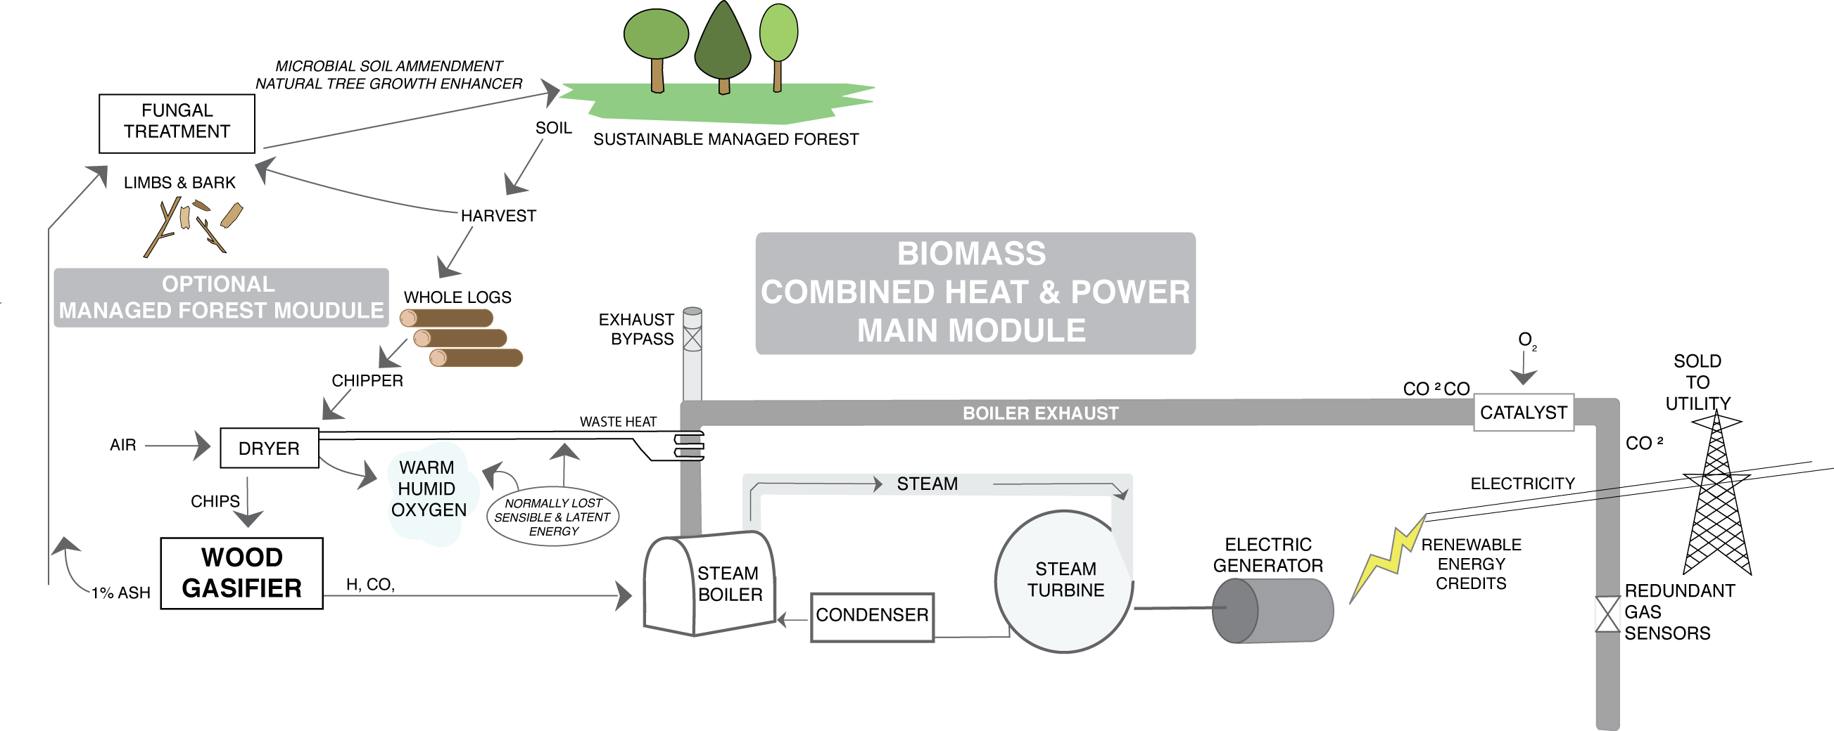
Sustainable Forest Management (SFM)

Slide 43
Biomass Generated Electricity & Sustainable Forest

Slide 44
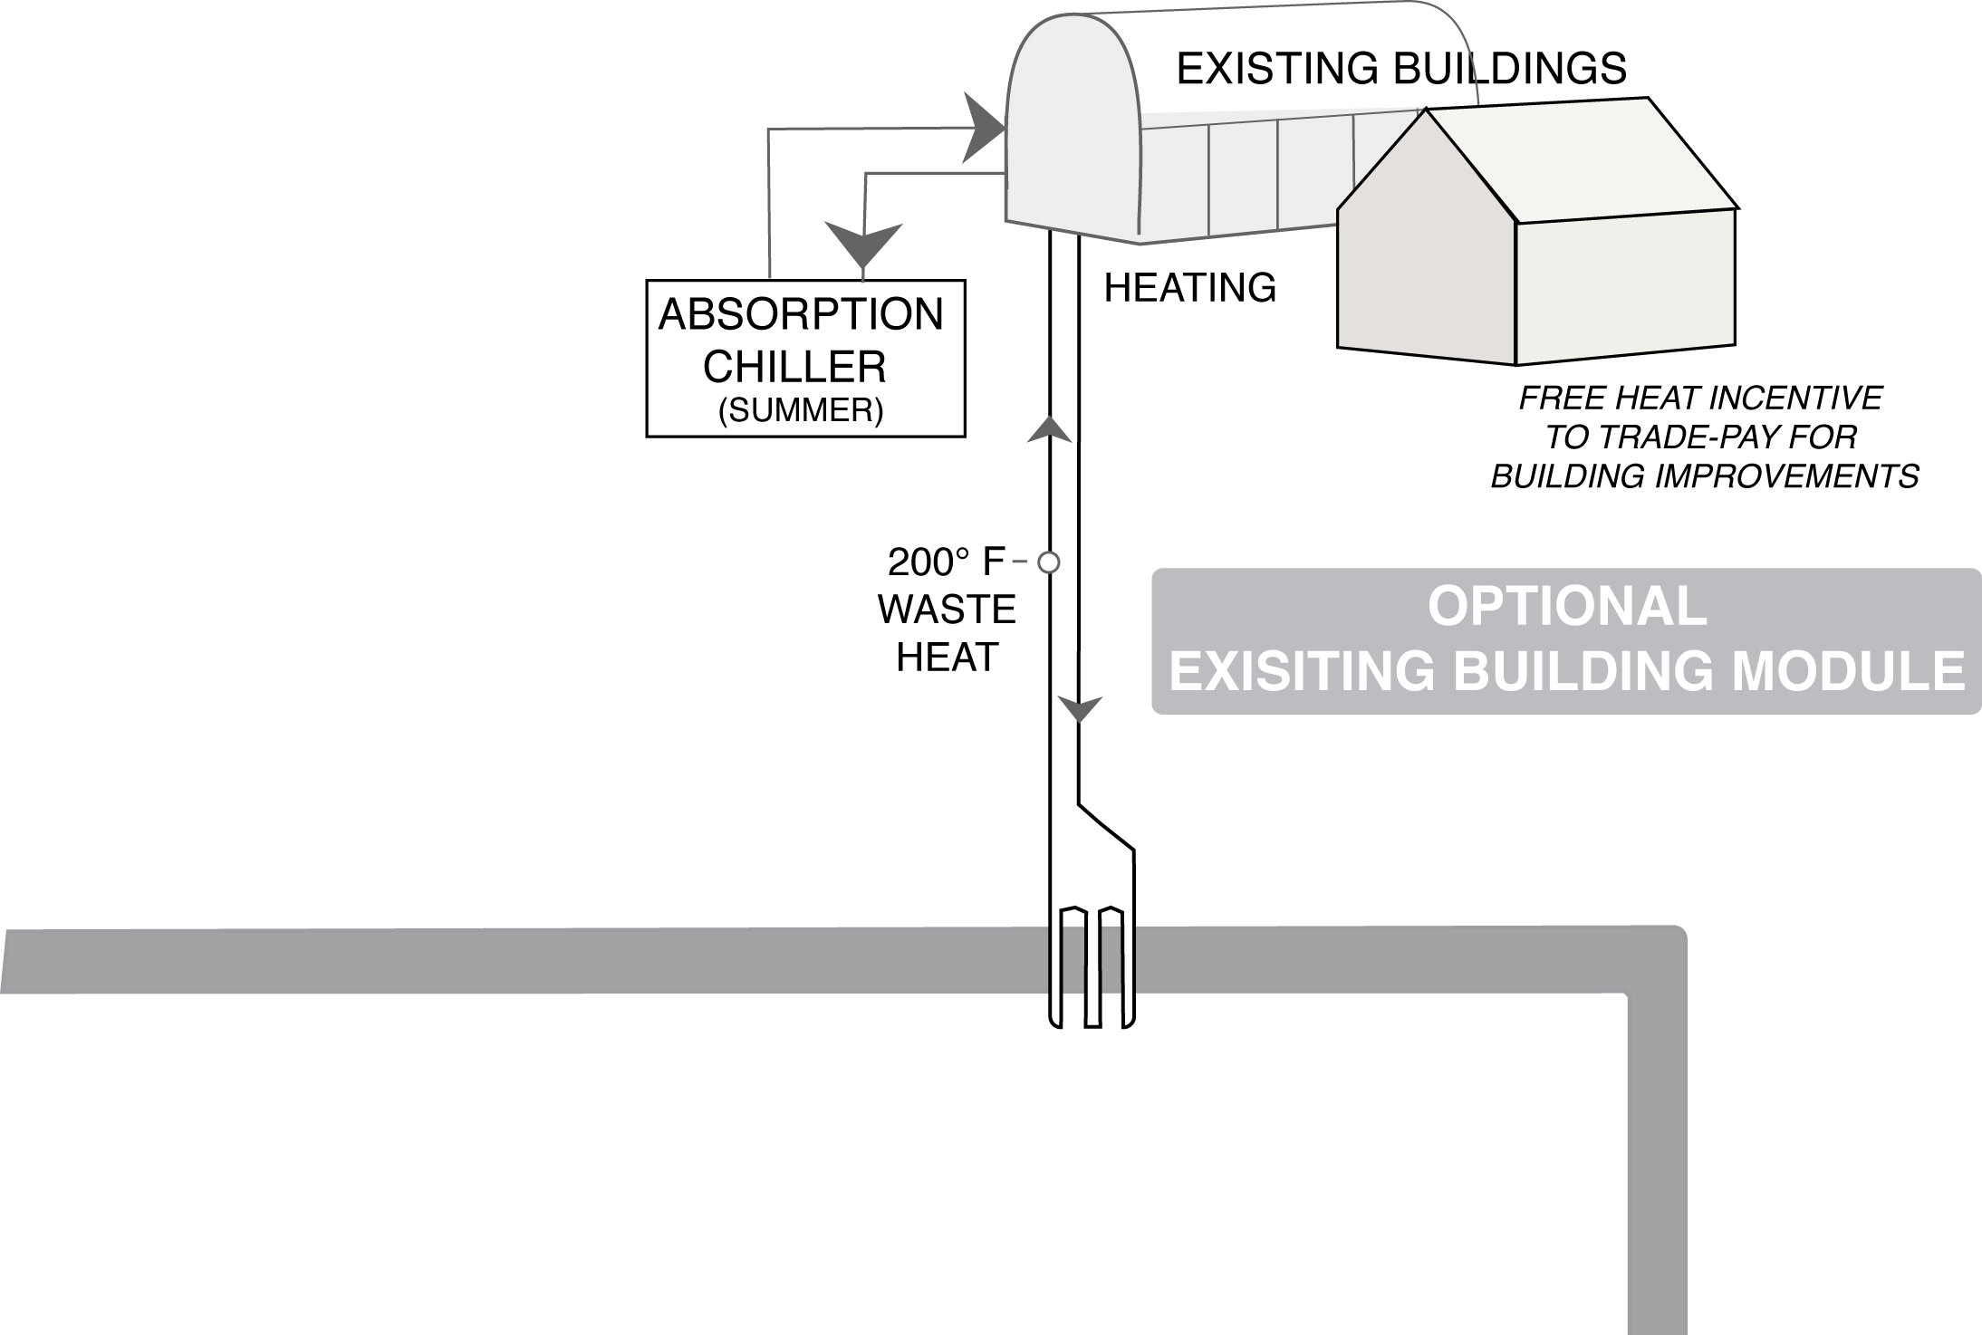
Using Waste Heat for the Buildings

Slide 45
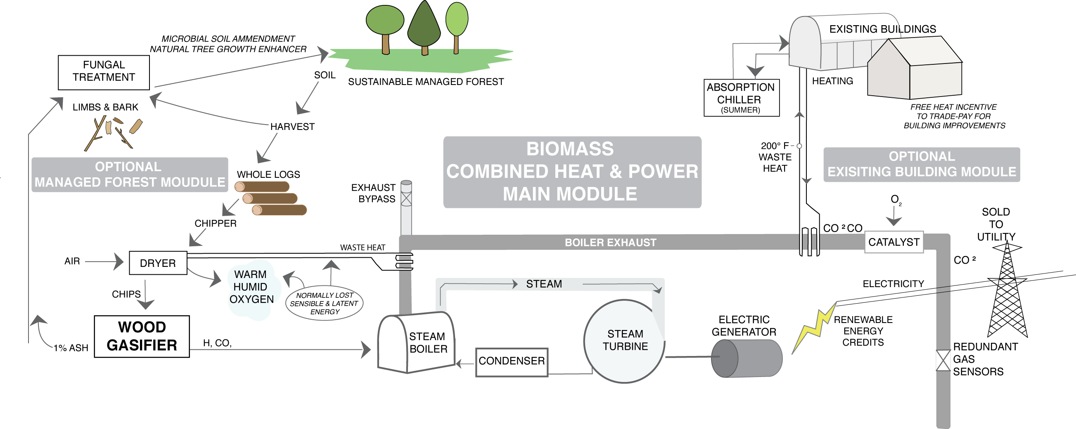
Biomass Heat and Power & Sustainable Forest

Slide 47
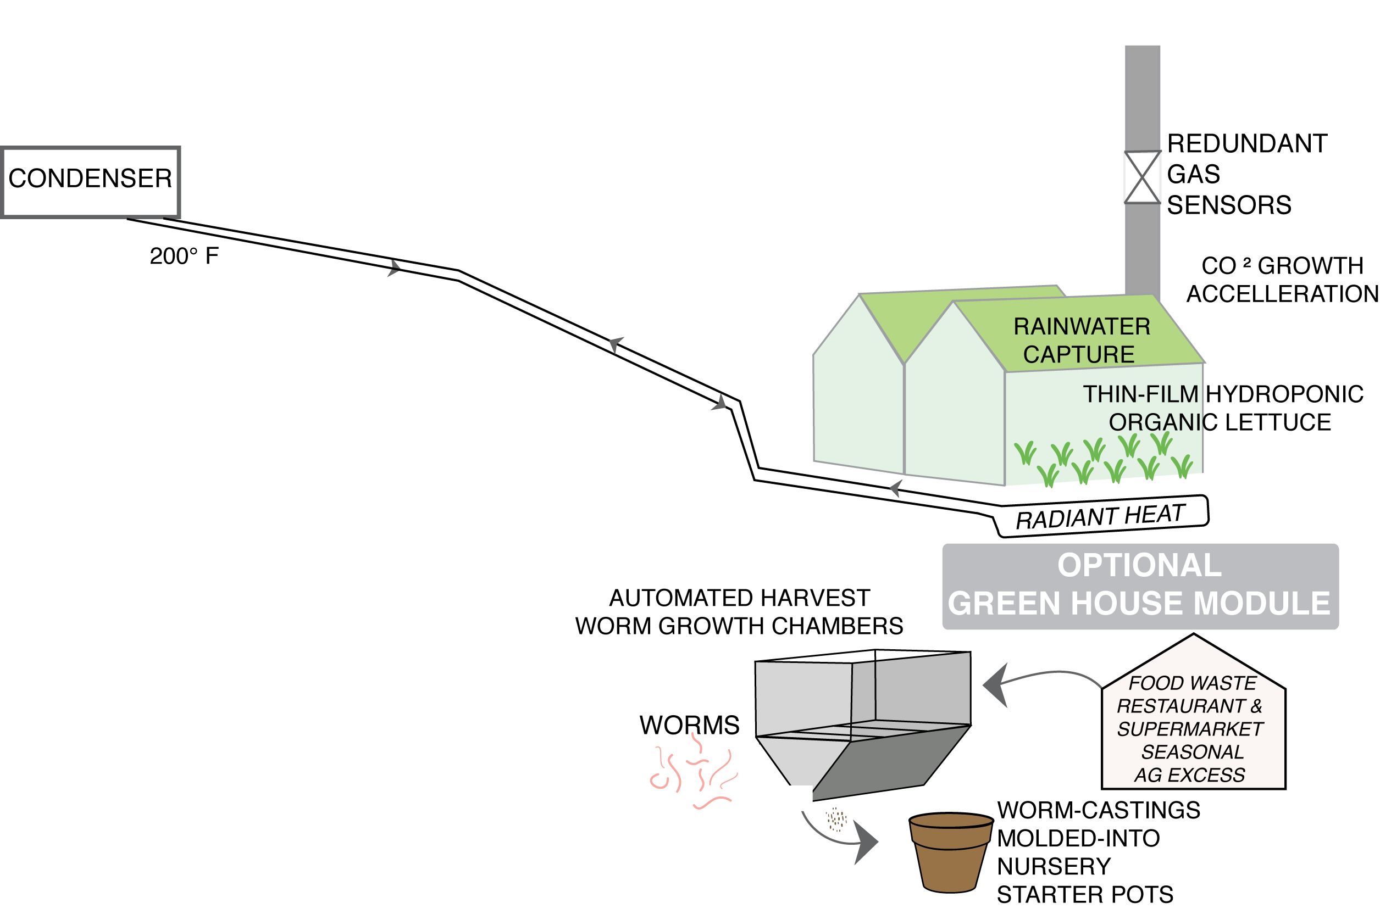
Hydroponic Greenhouse Option

Slide 48
Hydroponic Greenhouse Option
(with CO² Enhanced Growth)

Slide 49
Fresh LOCAL Food
in the WINTER?????

Slide 50
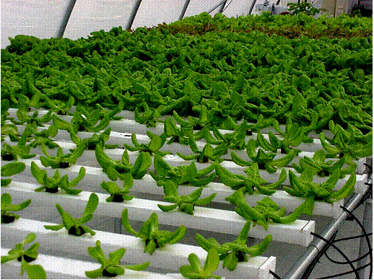
Hydroponic Lettuce
Uses 90% less water than lettuce grown in soil in California/ Arizona (where 90% of the Lettuce is grown in the US)

Slide 51
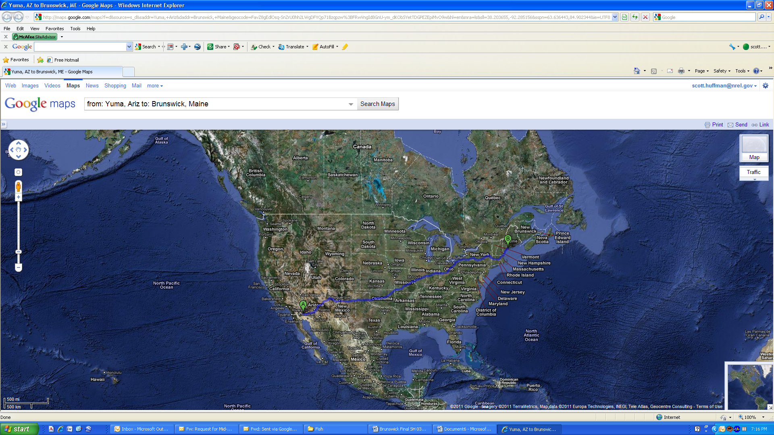
Lettuce Road Trip
3,026 miles that lettuce needs to travel from California to Brunswick, Maine
$135,000/Yr just in gasoline costs for shipping lettuce to the Tri-Cities area.

Slide 52
Hydroponic Greenhouse Option (with CO² Enhanced Growth)
& Worm Casting Starter Pots and Worms

Slide 53
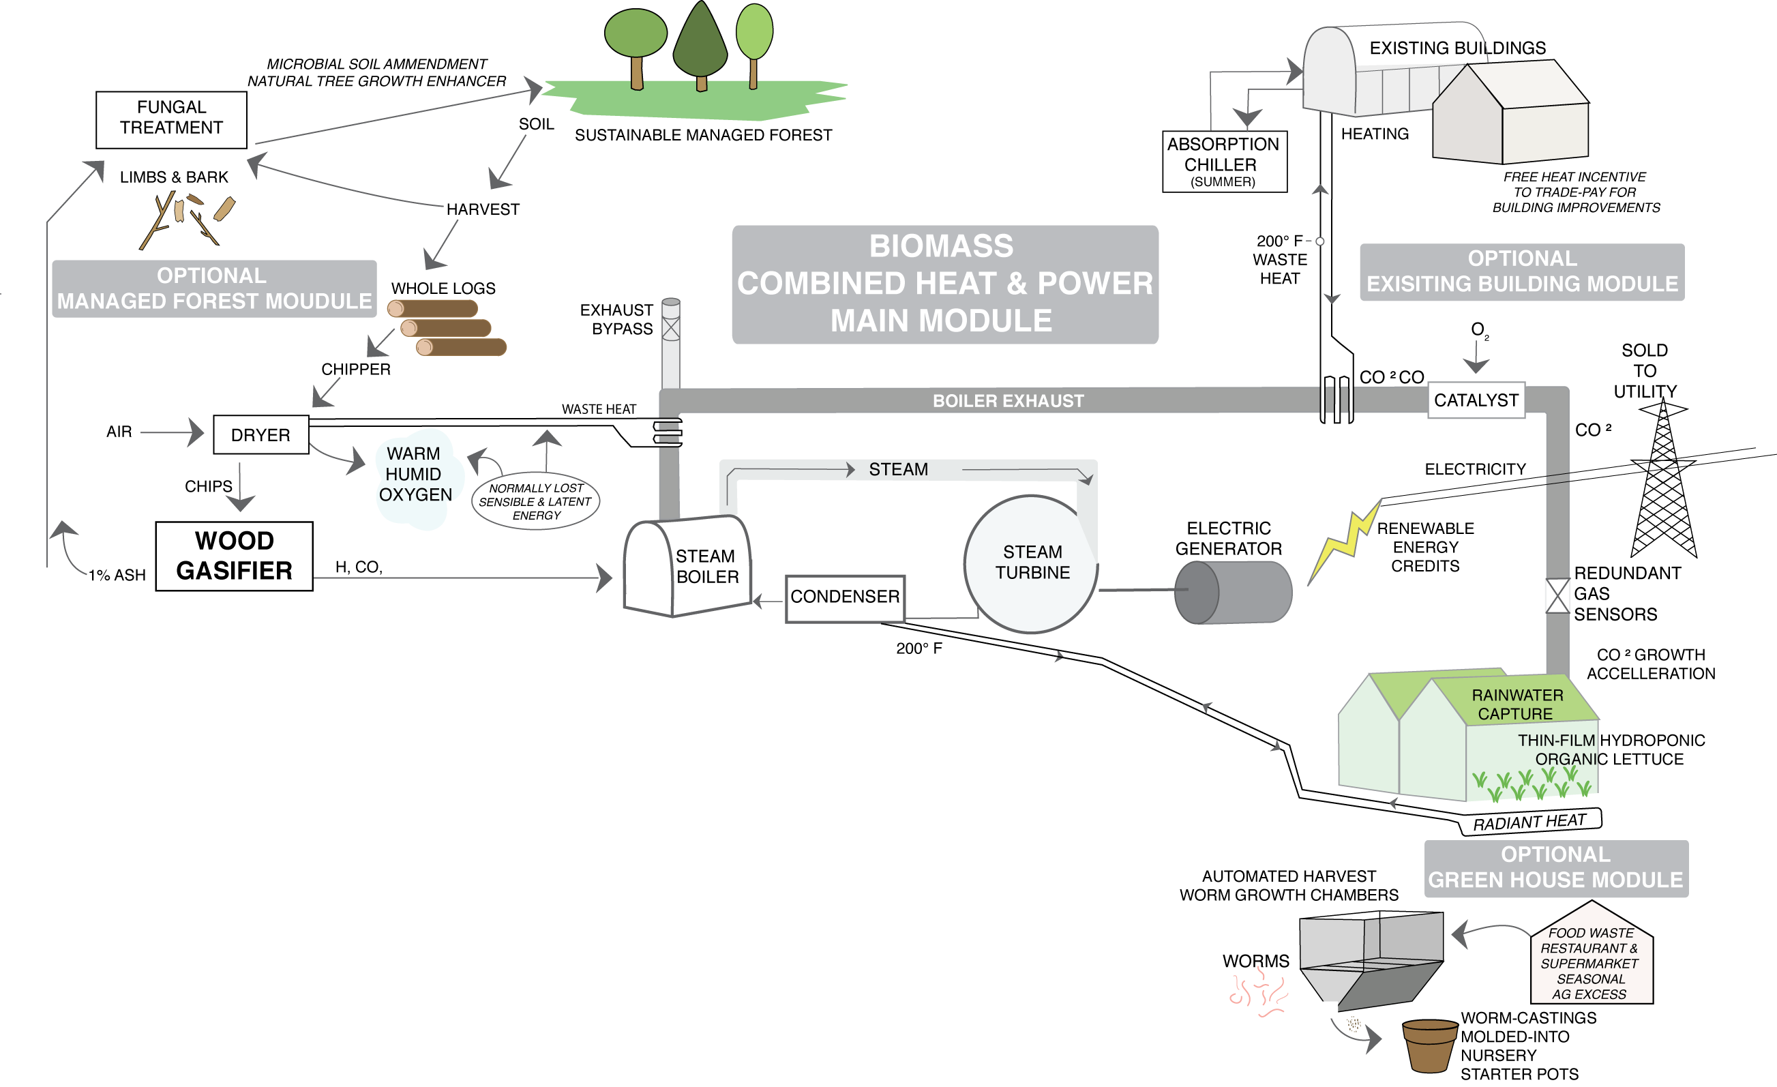
80% Efficient Power Plant !!!

Slide 54
Biomass Heat and Power, Sustainable Forest, Greenhouse Food, Nursery Pots

Slide 55
Biomass Heat and Power, Sustainable Forest, Greenhouse Food, Nursery Pots

Slide 56
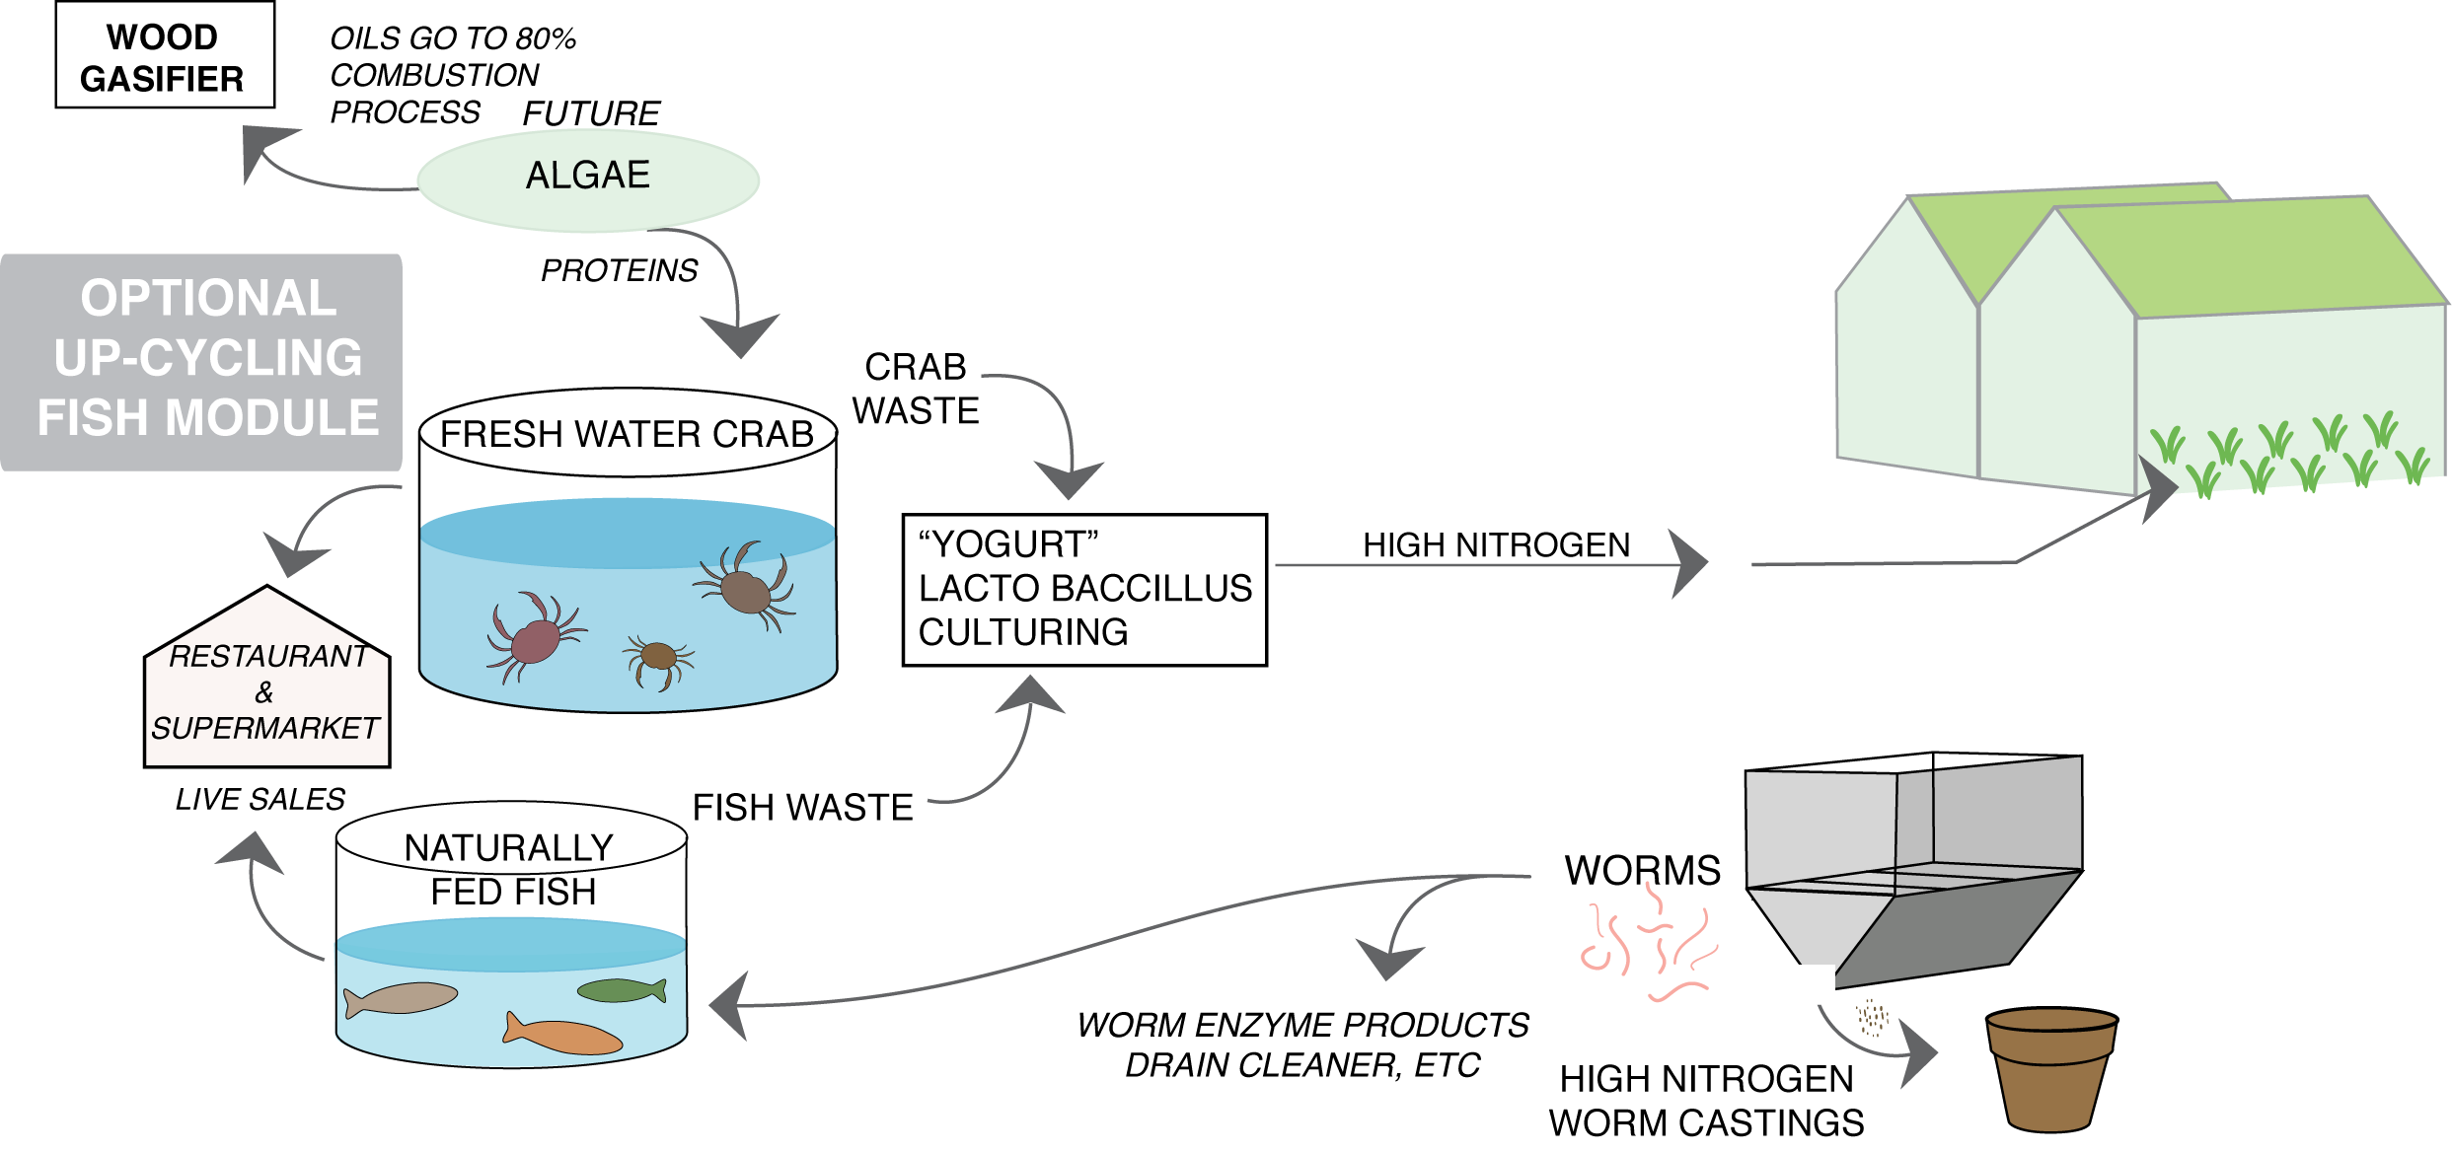
Fish Farming Option

Slide 57
Fish Farming Option

Slide 58
Fish Farming Option

Slide 59
Fish Farming Option
Organic Hydroponic

Slide 60
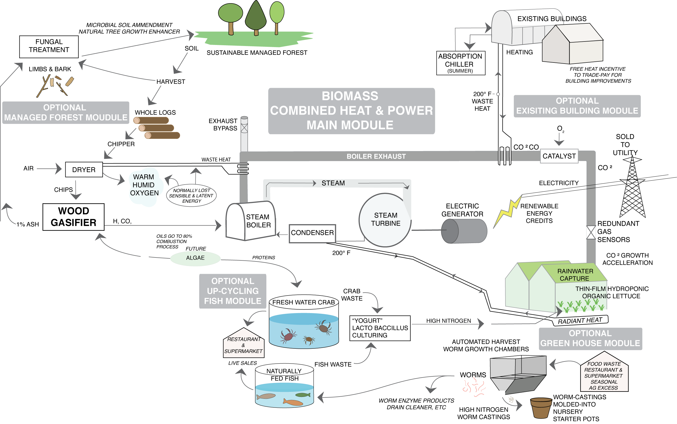

Slide 62
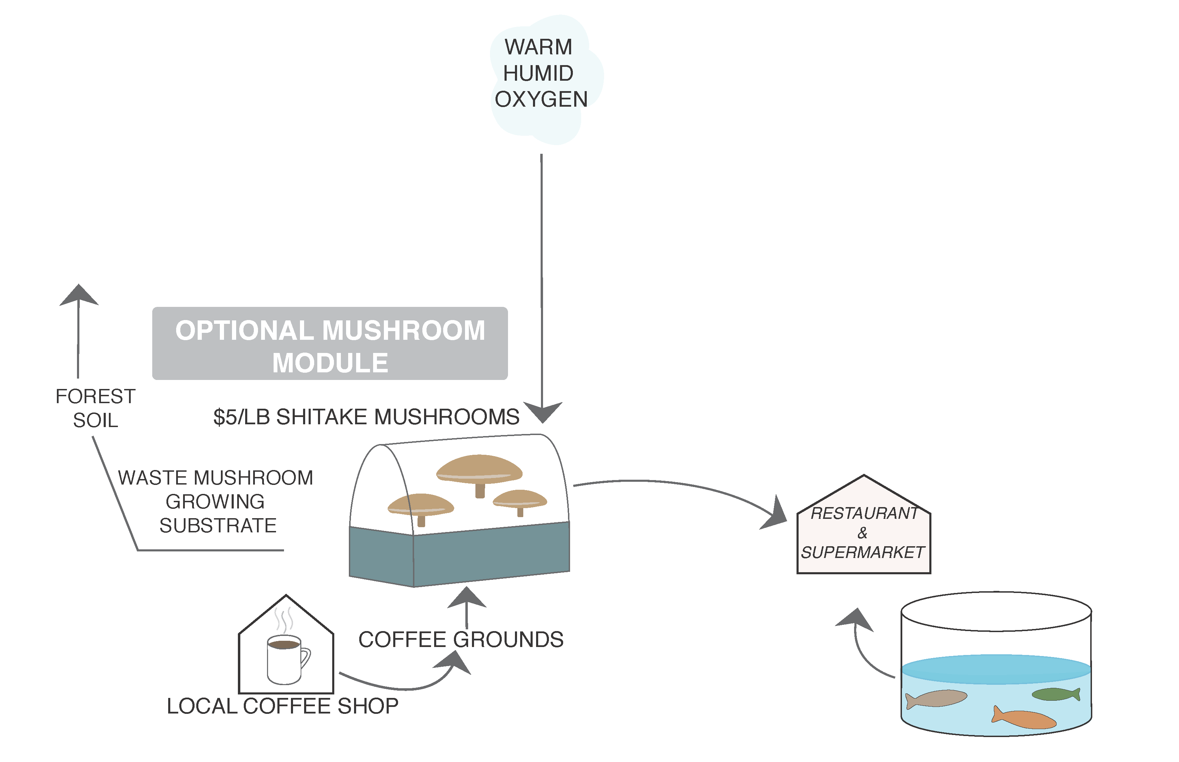
Mushroom Farming Option

Slide 63
Mushroom Farming Option

Slide 64
Mushroom Farming Option

Slide 65
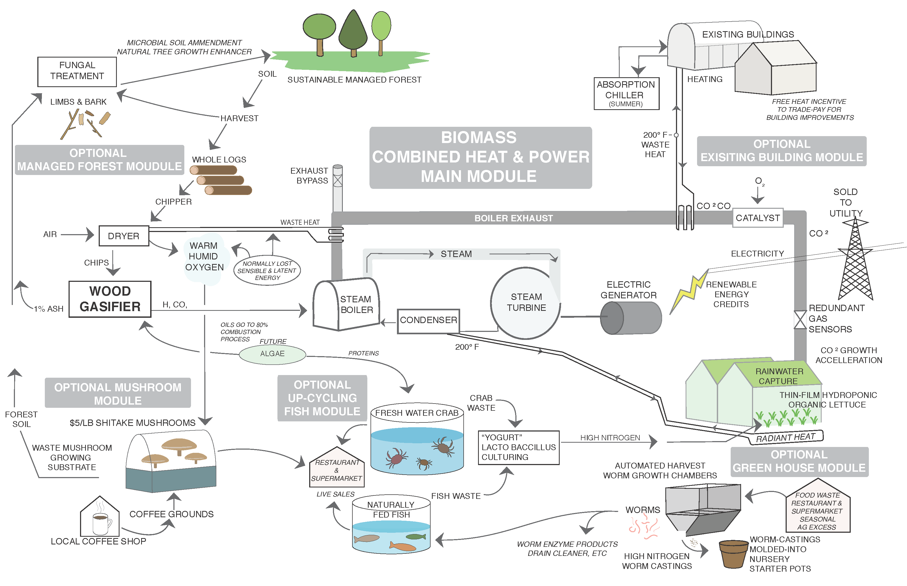

Slide 66
What else can we look at “Systemically”?
Transportation

Slide 67
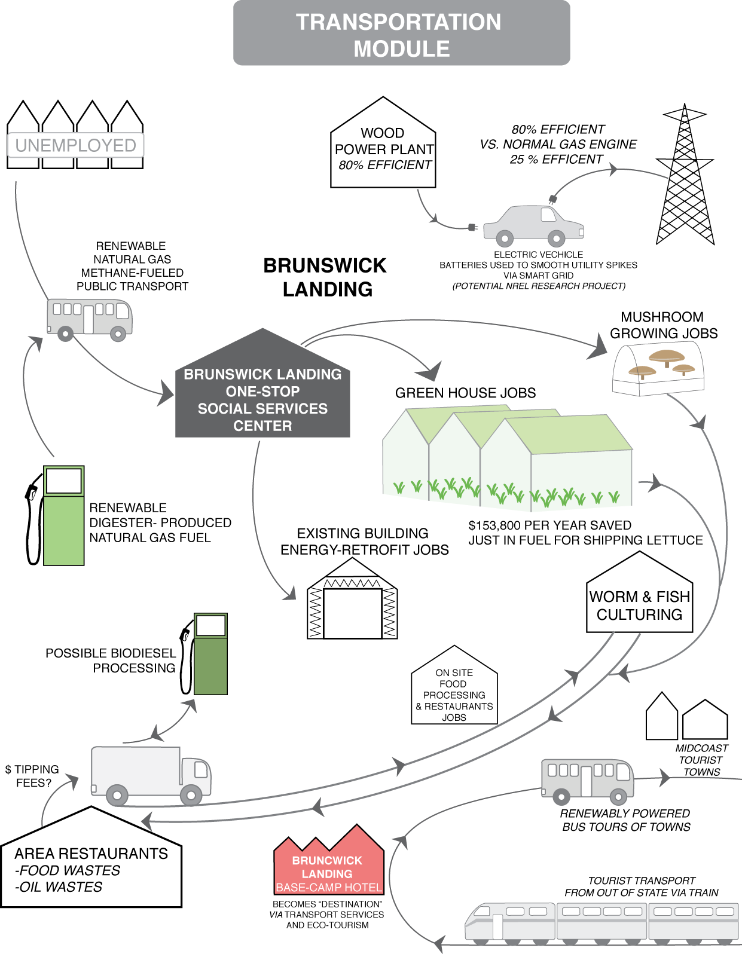

Slide 68
Financial Mechanisms and Incentives
Maine Community-Based Renewables Energy Production Incentive $0.10/kWh for up to 20 years.
Sale of Renewable Energy Credits $7/MWh (variable).
Federal Renewable Energy Tax Incentives $0.022/kWh for 10 yrs. But can only be used by “For-Profit” Entities
L3C Corporations have been called ”for-profit corporations with the soul of a non-profit”.
New Market Tax Credits
Other Potential Grants (State of Maine, USDA, others)
State of Maine Forest Service - Long Term Contract (Predictable Reduced Risk for Lender)

Slide 69
L3C Corporations
Different Vehicles: Sports Car vs. a Dump Truck
A For-Profit Corp with a Social Mission (Social Enterprise)
LLC Corp. (only with Low Profit) = L3C
Everything that Counts in Life Can’t be Measured
Cities are starting to create Public/Private Partnerships (PPP’s) to enhance “Quality of Life”
Social Mission allows Foundation Money to be “invested” with a low return (Low Profit)

Slide 70
Other Options for L3C Corporations
New Technology Incubators
Can be used to separate higher risk into different investment sections of a corporation to attract venture capital firms.
Allows new companies to ride through the “funding valley of death” until they receive venture capital.
Can be used to create Community Investment Corporations that Individuals can invest in.

Slide 71
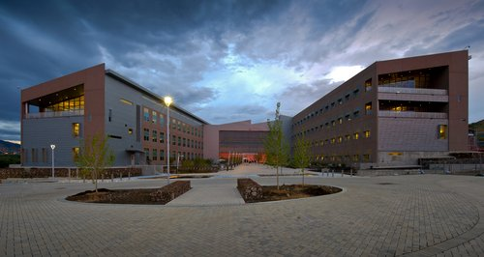
Questions?
Scott Huffman
Scott.Huffman@NREL.gov
http://www.nrel.gov/docs/fy12osti/50710.pdf

Slide 72
To Download or View the Report
http://www.nrel.gov/docs/fy12osti/50710.pdf

